Slide 1
2019 Bethel Study
And the Survey Says…
Trends in Affordability & Institutional Financial Health at CCCU Schools
(public version)
February 12, 2020
Dan Nelson
Chief Institutional Data & Research Officer
Bethel University

Slide 2
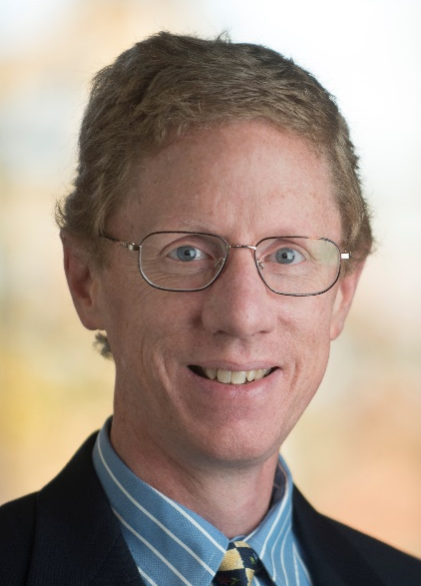
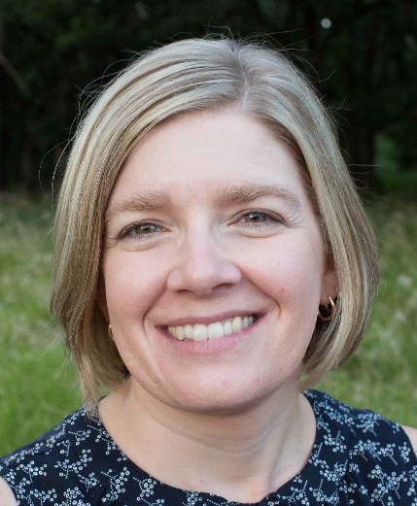
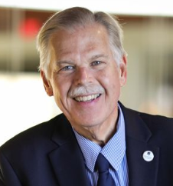
Authors
Stef Holm
Jeff Olson
Dan Nelson

Slide 3
Presentation Overview
Financial Aid Survey Highlights
Trends in Affordability
Trends in Institutional Financial Health
Impact of Loss of Government Funds
Additional Services Available
Q & A

Slide 4
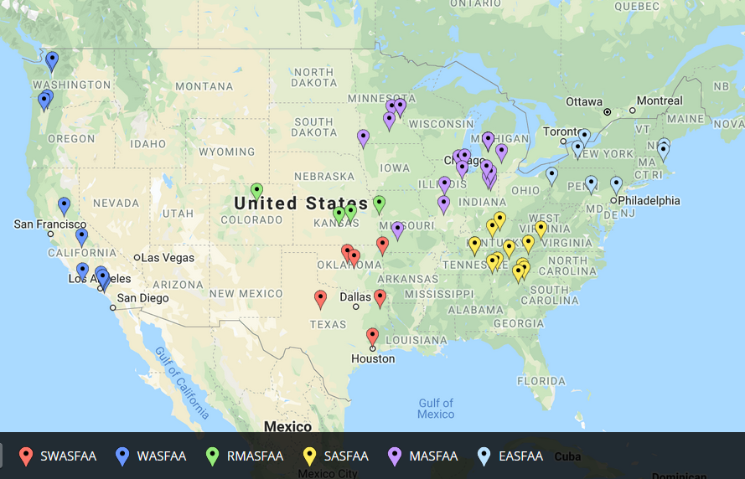
60 Participants – Nov. 19
http://batchgeo.com/
Notes:
1.) 2012-2014 – participation in low 80s
2.) 2015 about 75 participants
3.) 2016-2019 participation in low 60s
- Some regular participants no longer CCCU members
- 29 schools participated in last 5 surveys (2014-2019)
Load demographic data into the following website to generate map
https://batchgeo.com/
https://batchgeo.com/map/f00246fbee090081ded05535ace4d44b

Slide 5

Profile of Responding Schools
(see p. 3)
60 Schools in Cohort
CCCU Members
  Governing Member 87% (52/60)
  Associate Member 10% (6/60)
  Collaborative Partner 3% (2/60)
NASFAA Members
  Yes 95% (57/60)
  No 5% (3/60)
29 Schools participated in the 5 most recent CCCU Financial Aid surveys (down 8 from last year)
9 Schools have participated in all 21 CCCU Fin Aid surveys!
Notes:
Participants in al 17 surveys
Anderson University, IN Bethel University, MN Calvin College, MI Cedarville University, OH Houghton College, NY John Brown University, AR Messiah College, PA Roberts Wesleyan College, NY Tabor College, KS Taylor University, IN University of Northwestern - St Paul, MN Westmont College, CA Wheaton College, IL
50 schools participating in last 5 surveys:
Abilene Christian University, TX Anderson University, IN Arizona Christian University, AZ Asbury University, KY Bethel University, MN Biola University, CA Calvin College, MI Cedarville University, OH Colorado Christian University, CO Columbia International University, SC Cornerstone University, MI Crown College, MN East Texas Baptist University, TX Geneva College, PA George Fox University, OR Gordon College, MA Grace College, IN Greenville College, IL Houghton College, NY Indiana Wesleyan University, IN John Brown University, AR Kuyper College, MI Lee University, TN Lincoln Christian University, IL Malone University, OH Messiah College, PA Milligan College, TN Northwest Christian University, OR Northwest Nazarene University, ID Nyack College, NY Oklahoma Baptist University, OK Oklahoma Christian University, OK Olivet Nazarene University, IL Point Loma Nazarene University, CA Roberts Wesleyan College, NY Simpson University, CA Spring Arbor University, MI Tabor College, KS Taylor University, IN Toccoa Falls College, GA Trinity Christian College, IL Trinity International University, IL University of Northwestern - St Paul, MN University of the Southwest, NM University of Valley Forge, PA Warner Pacific College, OR Waynesburg University, PA Westmont College, CA Wheaton College, IL William Jessup University, CA

Slide 6
48 Schools Participated in at least
6 of the last 7 Surveys
135 schools participated in at least 1 survey
*Participated in all 21 surveys
Asbury Univ., KY
Bethel Univ., MN*
Biola Univ., CA
Bluefield Coll., VA
Calvin Coll., MI*
Campbellsville Univ., KY
CO Chr. Univ., CO
Corban Univ., OR
Cornerstone Univ., MI
Crown Coll., MN
Dordt Coll., IA
Emmanuel Coll., GA
Evangel Univ., MO
Fresno Pacific Univ., CA
Geneva Coll., PA
George Fox Univ., OR
Gordon Coll., MA
Grace Coll., IN
Greenville Coll., IL
Hope International Univ., CA
Houghton Coll., NY*
Huntington Univ., IN
IN Wesleyan Univ., IN
John Brown Univ., AR*
Lee Univ., TN
LeTourneau Univ., TX
Lincoln Chr. Univ., IL
Lipscomb Univ., TN
Messiah Coll., PA*
MidAmerica Nazarene Univ., KS
Milligan Coll., TN
Moody Bible Institute, IL
Nyack Coll., NY
OK Baptist Univ., OK
OK Chr. Univ., OK
Olivet Nazarene Univ., IL
Point Loma Nazarene Univ., CA
Roberts Wesleyan Coll., NY*
Spring Arbor Univ., MI
Sterling Coll., KS
Taylor Univ., IN*
Trevecca Nazarene Univ., TN
Trinity Chr. Coll., IL
Univ. of Northwestern - St Paul, MN*
Warner Pacific Coll., OR
Westmont Coll., CA*
Wheaton Coll., IL
William Jessup Univ., CA
Notes:
2018 1st time participants
Ouachita (wa –chee-tah) Baptist University, Arkansas
Pepperdine University, California

Slide 7
Financial Aid Survey Highlights
Enrollment by Type of Student
Reporting Relationships
One-Stop Shop
Strategic Partnerships
Use of Technology
Timing of freshmen financial aid offers
Documents Required
Income Share Agreements
Tuition reset experiences
Study Abroad Pricing
Presentation made to financial aid officers available at www.bethel.edu/institutional-data-research/bethel-study/survey-presentations/

Slide 8
2018-’19 Enrollment (see p. 4)
Of the 60 respondents:
  47 (78%) report non-traditional undergrads
  56 (93%) report graduate students
  60 (100%) report traditional undergrads
Notes:
2018:
Bachelor as highest degree offered at only 6.4% of participants, down from average of 10.9% over previous 5 surveys
56 schools reported graduate
Non-trad 1415: 75%
Grad 1415: 92%
Undergrad trad enrollment 1415: 116,580
Total enrollment 1415: 238,311
Non-trad 75% last year (1314)
Grad 89% last year (1314)

Slide 9
Financial Aid Reporting Relationships (see p. 190)
Where do financial aid offices reside in the school’s organizational structure (60 schools reporting)?

Slide 11
One-Stop Shop
21 Schools reported they are part of a One-Stop Shop.
Abilene Christian University, TX
Bluefield College, VA
Colorado Christian University, CO
Cornerstone University, MI
Eastern Nazarene College, MA
Fresno Pacific University, CA
Geneva College, PA
Gordon College, MA
Grace College, IN
Greenville University, IL
Houghton College, NY
Messiah College, PA
Milligan College, TN
Oklahoma Baptist University, OK
Olivet Nazarene University, IL
Roberts Wesleyan College, NY
Seattle Pacific University, WA
The Moody Bible Institute of Chicago, IL
Trevecca Nazarene University, TN
Warner Pacific University, OR
Wheaton College, IL

Slide 12
Strategic Academic Partnerships (see p. 256f)
In 2018-19 how many active strategic academic partnership agreements did your institution have with businesses, churches, or organizations?
54 respondents
See page 256 of the Participant Reports for more information.

Slide 13
Financial Aid Use of Technology
100% - use email reminders
85% - post aid awards to web
75% - Students respond to aid offer online
57% - Use document imaging
40% - Use social media (e.g. Facebook)
22% - Contact students using text message
8% - Use online financial aid chatrooms
Refer to pages 183-188 in the 2019 Participant Reports book to see which schools are using which technologies.

Slide 14
Timing of New Student Awards for 2020 (see p. 249ff.)
Traditional Undergraduate Programs
When will you begin awarding new students for 2020-21?
  39% starting November 2019.
  32% starting December 2019
  20% starting January 2020
  8% starting February 2020
  0% starting March 2020 or later
Notes:
When will you begin awarding new students for 2018-19?
50.0% starting November 2017.
40.3% starting December 2017
6.5% starting January 2018
1.6% starting February 2018
1.6% starting March 2018 or later
When will you begin awarding new students for 2017-18?
53.1% starting November 2016.
32.8% starting December 2016
7.8% starting January 2017
1.5% starting February 2017
4.6% starting March 2017 or later
Change: from F’17 to F’18 awarding
Earlier = 8; 16.0%
Same Month= 33; 66.0%
Later = 9; 18.0%

Slide 15
Documents required to complete a Financial Aid File: Applying for Need-Based Aid, Not Selected for Verification (see pp.239-241)
Notes:
2014-15 examples of “other:” Foundation application (Olivet Nazarene), FAFSA waiver (Valley Forge)
2014-15 “yes” to institutional aid app: Corban Univ., OR; East Texas Baptist Univ., TX; Emmanuel Coll., GA; Moody Bible Institute, IL; Nyack Coll., NY; Southwestern A.G. Univ., TX; Spring Arbor Univ., MI; Tabor Coll., KS; The Master's Coll. & Sem., CA; Univ. of the Southwest, NM; Westmont Coll., CA; Wheaton Coll., IL; William Jessup Univ., CA; Wisconsin Lutheran Coll., WI

Slide 16
Documents required to complete a Financial Aid File: Applying for Non-Need-Based Aid (see pp. 239-247)

Slide 17
Income Share Agreements
(see p. 250ff.)
To what extent are you using, or interested in offering, institutionally-funded Income Share Agreements for the following purposes? (54 respondents)

Slide 18
8 CCCU Schools* Completed Tuition Reset since 1516
(see p. 252ff.)
Traditional Undergraduate Programs
School | Year | Unfunded Discount Rate | Prior Year Tuition | Reset Tuition | $ Change | % Change
Bryan College, TN* | 2021 |  | $27,900 | $16,900 | $11,000 | 39.4%
Cornerstone U., MI | 1819 |  | $27,520 | $24,500 | $3,020 | 11.0%
The Master's Coll. & Sem., CA* | 1819 |  | $33,020 | $25,390 | $7,630 | 23.1%
Eastern Nazarene Coll, MA | 1819 |  | $31,780 | $25,598 | $6,182 | 19.5%
Univ. of Sioux Falls, SD | 1819 |  | $27,980 | $18,280 | $9,700 | 34.7%
Warner Pacific Univ., OR | 1819 |  | $24,500 | $18,660 | $5,840 | 23.8%
Grace College, IN | 1516 |  | $24,670 | $22,450 | $2,220 | 9.0%
Lincoln Christian Univ.,, IL | 1516 |  | $16,050 | $12,900 | $3,150 | 19.6%
* Includes former CCCU member institutions

Slide 19
Pricing of Full-Term Study Abroad Programs
Compared with Residential Programs (see pp. 231-232)
Average % of full-term study abroad students billed _______ than residential programs | 2006-07 (61 schools) | 2010-11 (62 schools) | 2014-15 (57 schools) | 2018-19 (40 schools)
Less | 9% | 13% | 13% | 21%
Similar | 62% | 53% | 58% | 50%
More | 29% | 34% | 29% | 31%

Slide 20
Affordability
Sticker Price – Tuition & Fees
Student Aid & Debt
Loan Defaults
Affordability at Select Peer Institutions

Slide 21
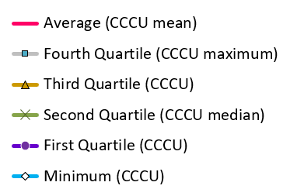
Chart Legend

Slide 22
Traditional Undergraduate Programs

Slide 23
Traditional Undergraduate Programs

Slide 24
Traditional Undergraduate Programs
5-7% 4-6% 3-5% 2-4%

Slide 25
Traditional Undergraduate Programs
Notes:
Includes Tuition Remission

Slide 26
Traditional Undergraduate Programs

Slide 27
Traditional Undergraduate Programs

Slide 28
Traditional Undergraduate Programs
Notes:
Over past 10 years, median borrowing went up $174 (0809 to 1819) which is 2.45%

Slide 29
Traditional Undergraduate Programs

Slide 30
Traditional Undergraduate Programs

Slide 31
3-Year Cohort Default Rates
Active CCCU Members
Most recent three-year default rate on government loans (FY2016 official).
54% (70 of 129) of CCCU members have default rates less than 6.3%, and 87% (112 of 129) of rates are below 10.1%
National Average Default Rate – All Schools (10.1%)
National Average Default Rate – Private 4-Year (6.3%)
SOURCE: U.S. Department of Education Default Management, Official Cohort Default Rates for Schools, retrieved 11.27.2019 https://www2.ed.gov/offices/OSFAP/defaultmanagement/cdr.html

Slide 32
Traditional Undergraduate Programs

Slide 33
Traditional Undergraduate Programs

Slide 34
Institutional Financial Health
Enrollment
Discount Rates
Family Ability to Pay
  Need
  Wealth
Net Tuition Revenue

Slide 35
Traditional Undergraduate Programs

Slide 38
Percentage of 2018-19 Institutional Gift Aid (IGA) that is “funded” (see p. 41)
Traditional Undergraduate Programs
The typical (median) school reports that 4.9% of institutional gift aid (not including tuition remission) has a specific funding source (endowed or restricted).
  6 schools report that over 15% of IGA is funded.
  3 schools report between 10-15% of IGA is funded
  21 schools report between 5.0-9.9% of IGA is funded
  30 schools report that less than 5% of IGA is funded
Notes:
Fall 2018 survey data below
The typical (median) school reports that 3.9% of institutional gift aid (not including tuition remission) has a specific funding source (endowed or restricted).
3 schools report that over 15% of IGA is funded.
9 schools report between 10-15% of IGA is funded
15 schools report between 5.0-9.9% of IGA is funded
35 schools report that less than 5% of IGA is funded
Fall 2015 survey data (2014-15) below:
5 schools report that over 15% of IGA is funded.
10 schools report between 10-15% of IGA is funded
13 schools report between 5.0-9.9% of IGA is funded
47 schools report that less than 5% of IGA is funded
Fall 2016 data below
The typical (median) school reports that 4.1% of institutional gift aid (not including tuition remission) has a specific funding source (endowed or restricted).
3 schools report that over 15% of IGA is funded.
4 schools report between 10-15% of IGA is funded
18 schools report between 5.0-9.9% of IGA is funded
39 schools report that less than 5% of IGA is funded

Slide 39
Traditional Undergraduate Programs
Estimated

Slide 40
“Target” Unfunded Discount Rate for 2019-20 New Students (see p. 129)
Traditional Undergraduate Programs
 | New Student Target Rate | All Student Estimated Rate | Gap
Minimum | 21.0% | 18.0% | +3.0 Points
First Quartile | 45.0% | 41.8% | +3.2 Points
Median | 51.9% | 46.7% | +5.2 Points
Third Quartile | 55.2% | 49.4% | +5.8 Points
Maximum | 65.0% | 63.6% | +1.4 Points
CCCU Median New Student Target Rate was 50% in 2018-19.

Slide 41
Traditional Undergraduate Programs

Slide 42
Traditional Undergraduate Programs

Slide 43
Price compared with Family Wealth
(see p. 157ff.)
Traditional Undergraduate Programs
The "wealth index" is an approximate measurement of expected parent contribution from non-independent student families (whether or not they show need).
A positive variance means that, compared to other reporting schools, families are wealthier than the norm.

Slide 44
Price Compared with Family Wealth: 2018-19
Traditional Undergraduate Programs

Slide 45
Traditional Undergraduate Programs

Slide 46
Traditional Undergraduate Programs

Slide 47
Traditional Undergraduate Programs

Slide 48
Traditional Undergraduate Programs

Slide 49
Traditional Undergraduate Programs

Slide 50
Takeaways
From FY03-FY19 Traditional undergrad enrollment flat or declining at most CCCU schools
Since 2014-15, YOY change in net tuition revenue from traditional undergraduate programs declined at half of CCCU institutions
Families ability to pay was flat from FY08-FY15 while median tuition increased by 30% over this time
Institutions’ massive investment in unfunded institutional gift aid has not resulted in increased net tuition revenue at most CCCU schools

Slide 51
14 schools had more Aggregate Net Tuition Revenue in 2018-19 than in 2013-14
Traditional Undergraduate Programs
The financial aid office reported to Enrollment in 12-13 at 43% of these schools
The unfunded discount rate increased 3.29 points from 1314 to 1819
The enrollment (trad UG FISAP) increased by an average of 7 students (only 5 of the 14 schools had larger trad UG enrollment in 1819 than in 1314)
The average net price per student increased by an average of $2,401 (11.5%)
FT FY Tuition and Fees increased by an average of $5,192 (20.8%)

Slide 52
24 schools had less Aggregate Net Tuition Revenue in 2018-19 than in 2013-14
Traditional Undergraduate Programs
The financial aid office reported to Enrollment in 12-13 at 71% of these schools
The unfunded discount rate increased 6.14 points from 1314 to 1819
The enrollment (trad UG FISAP) decreased by an average of 135 students
The average net price per student increased by an average of $1,765 (8.6%)
FT FY Tuition and Fees increased by an average of $3,874 (15.2%)

Slide 53
Aggregate NTR Summary
Traditional Undergraduate Programs
Schools whose aggregate net tuition revenue increased from FY14 to FY19 were more likely to…
  constrain growth in unfunded discount rate, and
  pass along a greater percent of tuition increases to students and families…
than schools whose aggregate net tuition revenue declined over the same period.

Slide 54
Impact of Loss of Government Funds
Loss of government grants would have a varied impact on Christian colleges
  Lesser impact on schools enrolling middle- and upper-income families
  Severe impact on schools enrolling lower-income families
Loss of government loans
  Some schools will be able to arrange bank financing to fill the gap
  The hardest hit schools are those serving substantial numbers of low-income students from families with low credit ratings
Ironically, the biggest losers if government aid were curtailed would be the neediest students (and the Christian colleges that serve them), the very group that government financial aid programs were designed to help.

Slide 58
Additional Services Available
Customized version of this presentation
  Add your institution to each of the longitudinal slides
  Add select peer institutions (if sufficient data is available) of your choosing
  Cost is $400 ($250 if you sign up by March 1st)
  Email jeff-olson@bethel.edu, including the names of the peer institutions you’d like included
Consulting
  Dan Nelson will present to your leadership team, board of trustees, etc.
  Includes customized version of this PowerPoint presentation
  Email dc-nelson@bethel.edu for more information

Slide 59

Questions?
Contact Dan Nelson or Jeff Olson if you have specific questions
  dcnelson@bethel.edu
  jeff-olson@bethel.edu

